Slide 1

Drug Epidemic Tracking through social media
Justin Wahl
Raul Martinez
Ivan Ulloa
University of California, San Diego
DSE203 – December 5th, 2020

Slide 2
Project Goals
Explore Data
CDC, VA
Reddit Posts
US News
Schema
Feature Selection and Data Integration
Build Knowledge Graph
(Neo4j)
Explore Drug Trends using Social Media (Neo4j)

Slide 3




Data sources
- List of drug street, brand, and generic names (provided)
- VA Product Names and Class Codes (provided)
- VA Class Categories
- FDA/DEA Drug Schedule List and Categories (DBpedia)
- US News articles (provided)
- Reddit posts from r/Drugs

Slide 4
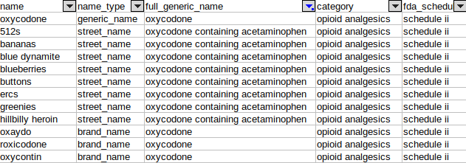
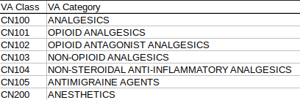
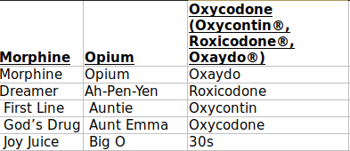
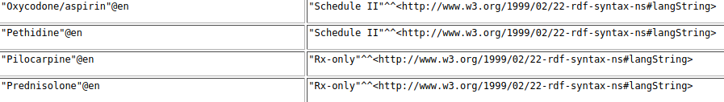
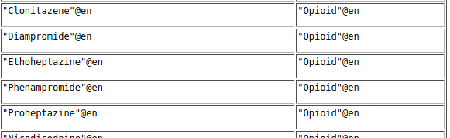
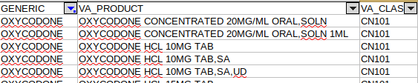
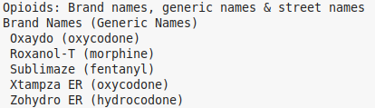
Drug names
VA Products and Category Codes (CSV)
Street and generic names (CSV)
DBPedia (SparQL query)

Slide 5
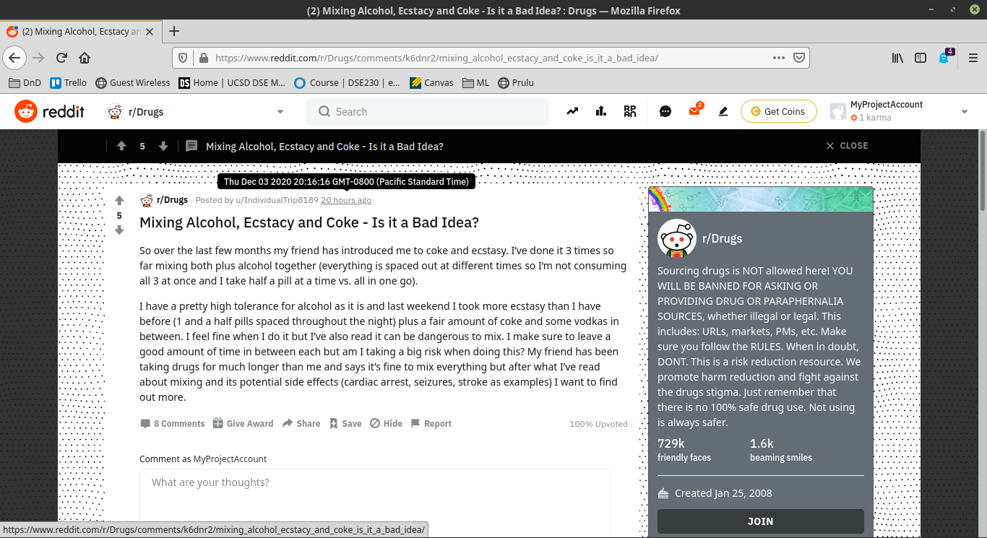
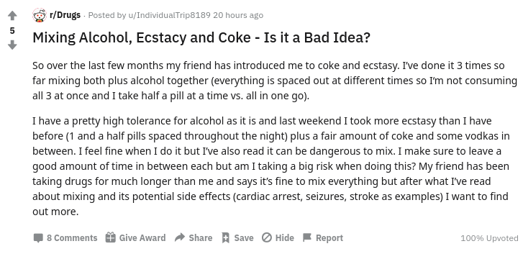
Reddit data
author
created
score
title
Pushshift
Reddit aggregator
Historical dataset
PSAW
Pushshift API wrapper
css_flair_text
selftext
num_comments
upvote_ratio

Slide 6
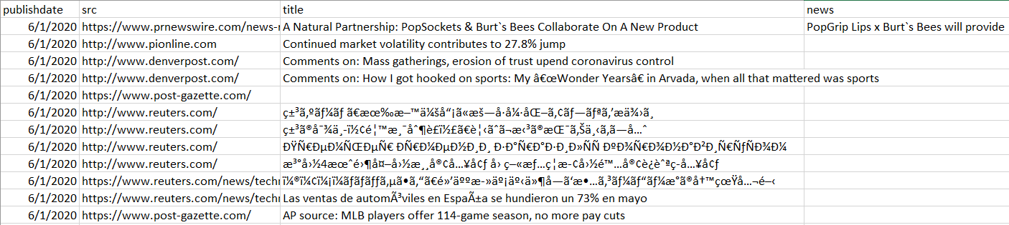
US news
Empty Cells
Encoding
Language
Data provided by Professor Amarnath Gupta
Data Cleaning:
Empty cells and duplicates, English language detection, fix ISO-8859-1/latin1 format, article relevance with bag of words (drug abuse and overdose from NIH and CDC websites)
Number of news articles was reduced from 542,607 to 293,627 (null values: 833 in 'title' and 52,953 in 'news')
Removed Stop and Common Words from nltk.corpus library
https://www.drugabuse.gov/publications/media-guide/glossary
https://www.cdc.gov/drugoverdose/opioids/terms.html
Ex. Addiction, dependence, abuse

Slide 7
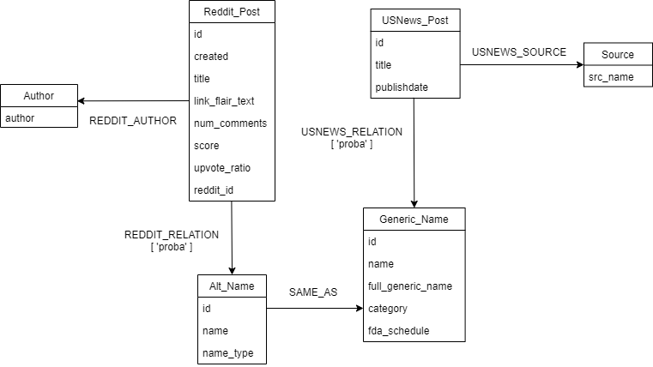
Graph Schema

Slide 8
Challenges
No standard drug naming across data sources
Many street names are common words and are used for more than one drug
Common words create out-of-context matches
Similarity matching does not perform well against long text
False positive rate increases with number of street names
Street Name
K
K
Generic Name
Clonazepam
Ketamine
death of Coca-Cola 'addict' may be linked to her caffeine consumption
what the heroin industry can teach us about solar power
Drug
Cannabis
Cocaine
Crack Cocaine
Heroin
Frequency
357
378
146
283

Slide 9
matching
Reddit
Posts
Reddit Posts (clean)
Clean
Black Box Blocker
Manual Labeling
Black Box Features
RF Matcher
CDC Data
All Drug Names
ALL
VA Data
GENERIC
Black Box Blocker
Manual Labeling
Black Box Features
RF Matcher
Clean
US News Articles
US News Clean
Clean

Slide 10
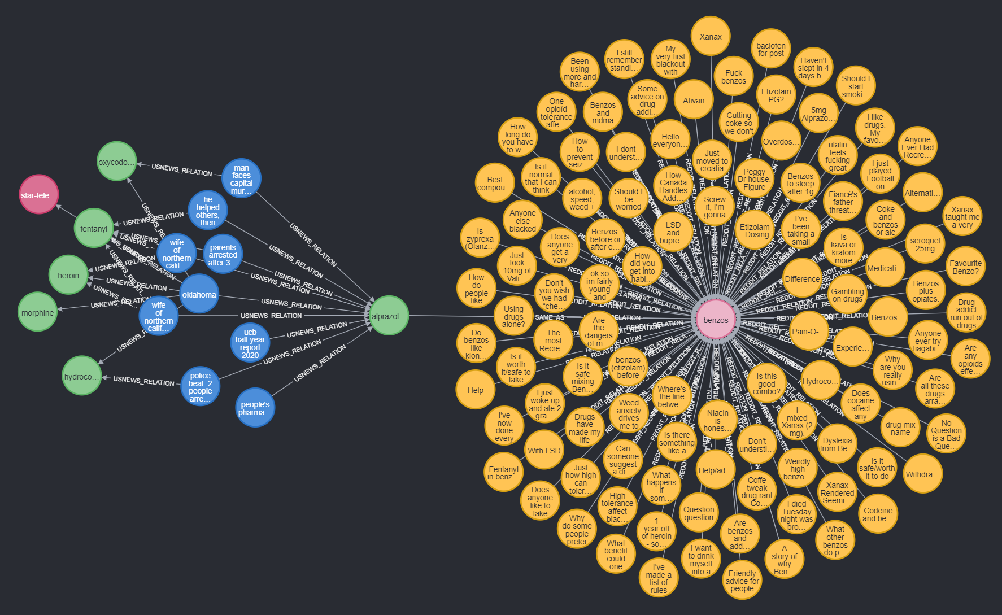
Knowledge Graph
Other Generic Names (Related)
Generic Name:
Alprazolam
Reddit Posts
News Source:
Star-Telegram
US News Title
“Oklahoma authorities concerned with spike in overdose deaths”
Street Name:
Benzos

Slide 11
Most common drugs

Slide 12
Graph demo

